Slide 1
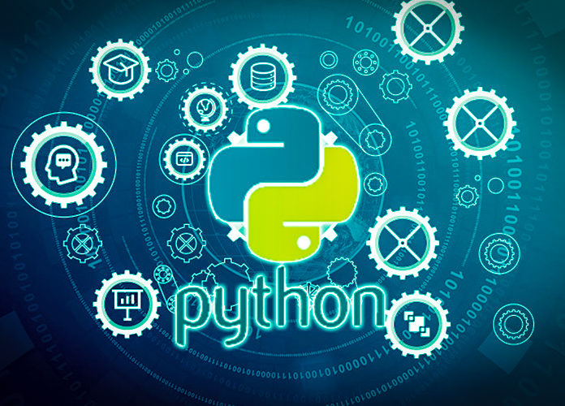
Data Programming in Python _________________ Module 6 Wrap-up

Slide 2
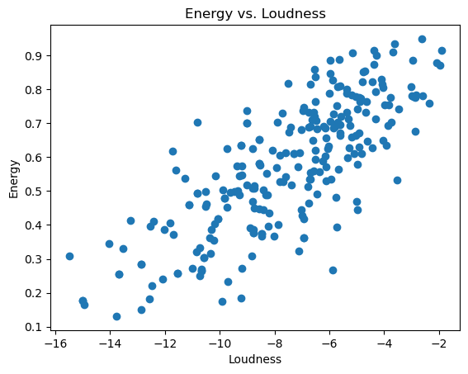
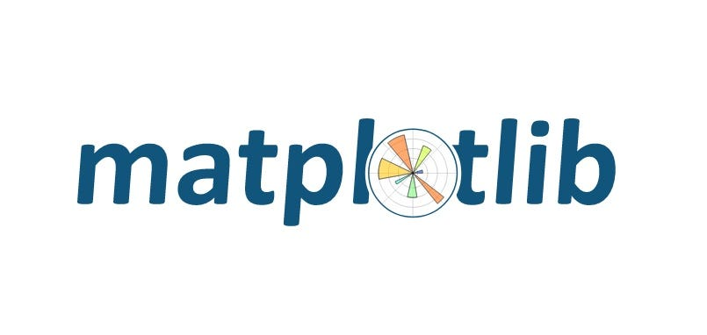
BAIS 6040: Data Programming in Python
Module Objectives:
Plot basic plots in Matplotlib
Utilize AI to improve graphs
Create plots to visually demonstrate analysis

Slide 3
BAIS 6040: Data Programming in Python
We learned:
How to create line graphs, bar plots, histograms, scatter, box and pie charts
Utilizing Copilot for easier graphing
Visualizing real-world data in plots

